Slide 1
Introduction to Embedded System Design using Zynq
Zynq
Vivado 2014.2 Version

Slide 2
Objectives
After completing this module, you will be able to:
Define a Zynq All Programmable SoC (AP SoC) processor component
Enumerate the key aspects of the Zynq AP SoC processing system
Describe the embedded design flow
Understand the function of the IP Integrator tool
Indicate how the hardware design is linked to the software development environment

Slide 3
Outline
Embedded Processor Component
Overview of Vivado for Embedded System Design
Embedded System Development Flow
Hardware Platform Creation
SDK Software Platform
Summary

Slide 4
Embedded Design Architecture in Zynq
Embedded design with Zynq is based on:
Processor and peripherals
Dual ARM® Cortex™ -A9 processors of Zynq-7000 AP SoC
AXI interconnect
AXI component peripherals
Reset, clocking, debug ports
Software platform for processing system
Bare Metal Applications or OS’s (e.g. Linux, FreeRTOS)
C language support
Processor services
C drivers for hardware
User application
Interrupt service routines (optional)

Slide 5
The PS and the PL
The Zynq-7000 AP SoC architecture consists of two major sections
PS: Processing system
Dual ARM Cortex-A9 processor based
Multiple peripherals
Hard silicon core
PL: Programmable logic
Uses the same 7 series programmable logic
Artix™-based devices: Z-7010, Z-7015 and Z-7020 (high-range I/O banks only)
Kintex™-based devices: Z-7030, Z-7045, and Z-7100 (mix of high-range and high-performance I/O banks)

Slide 6
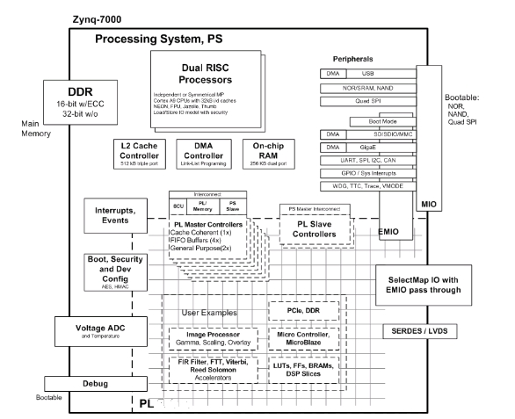
PS Components
The Zynq AP SoC processing system consists of the following blocks
Application processing unit (APU)
I/O peripherals (IOP)
Multiplexed I/O (MIO), extended multiplexed I/O (EMIO)
Memory interfaces
PS interconnect
DMA
Timers
Public and private
General interrupt controller (GIC)
On-chip memory (OCM): ROM and RAM
Debug controller: CoreSight

Slide 7
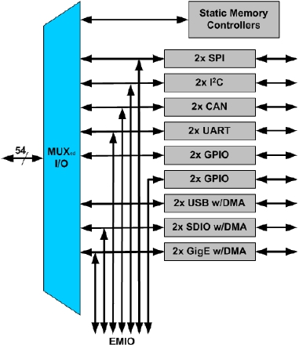
Zynq Architecture Built-in Peripherals
Two USB 2.0 OTG/Device/Host
Two Tri- Mode GigE (10/100/1000)
Two SD/SDIO interfaces
Memory, I/O and combo cards
Two CAN 2.0Bs, SPIs , I2Cs, UARTs
Four GPIO 32bit Blocks
54 available through MIO; other available through EMIO
Multiplexed Input/Output (MIO)
Multiplexed pinout of peripherals and static memories
Extended MIO
Maps PS peripheral ports to the PL

Slide 8
Outline
Embedded Processor Component
Overview of Vivado for Embedded Design
Embedded System Development Flow
Hardware Platform Creation
SDK Software Platform
Summary

Slide 9
Vivado
What are Vivado, IP Integrator and SDK?
Vivado is the tool suite for Xilinx FPGA design and includes capability for embedded system design
IP Integrator, is part of Vivado and allows system level design of the hardware part of an Embedded system
Integrated into Vivado
Vivado includes all the tools, IP, and documentation that are required for designing systems with the Zynq-7000 AP SoC hard core and/or Xilinx MicroBlaze soft core processor
Vivado + IPI replaces ISE/EDK
SDK is an Eclipse-based software design environment
Enables the integration of hardware and software components
Links from Vivado
Vivado is the overall project manager and is used for developing non-embedded hardware and instantiating embedded systems
Vivado/IP Integrator flow is recommended for developing Zynq embedded systems using 2013.2 and later

Slide 10
Vivado Components
Vivado/IP Integrator
Design environment for configuration of PS, and hardware design for PL
Hardware Platform (xml)
Platform, software, and peripheral simulation
Vivado logic analyzer integration
Software Development Kit (SDK)
Project workspace
Hardware platform definition
Board Support Package (BSP)
Software application
Software debugging
Hardware Design
HW/SW Simulation
Software Design
HW/SW Debug

Slide 11
Embedded System Tools: Hardware
Hardware and software development tools
IP Integrator
IP Packager
Hardware netlist generation
Simulation model generation
Xilinx Microprocessor Debugger (XMD)
Hardware debugging using Vivado analyzer

Slide 12
Embedded System Tools: Software
Eclipse IDE-based Software Development Kit (SDK)
Board support package creation
GNU software development tools
C/C++ compiler for the MicroBlaze and ARM Cortex-A9 processors (gcc)
Debugger for the MicroBlaze and ARM Cortex-A9 processors (gdb)
TCF framework – multicore debug
Board support packages (BSPs)
Stand-alone BSP
Free basic device drivers and utilities from Xilinx
NOT an RTOS

Slide 13
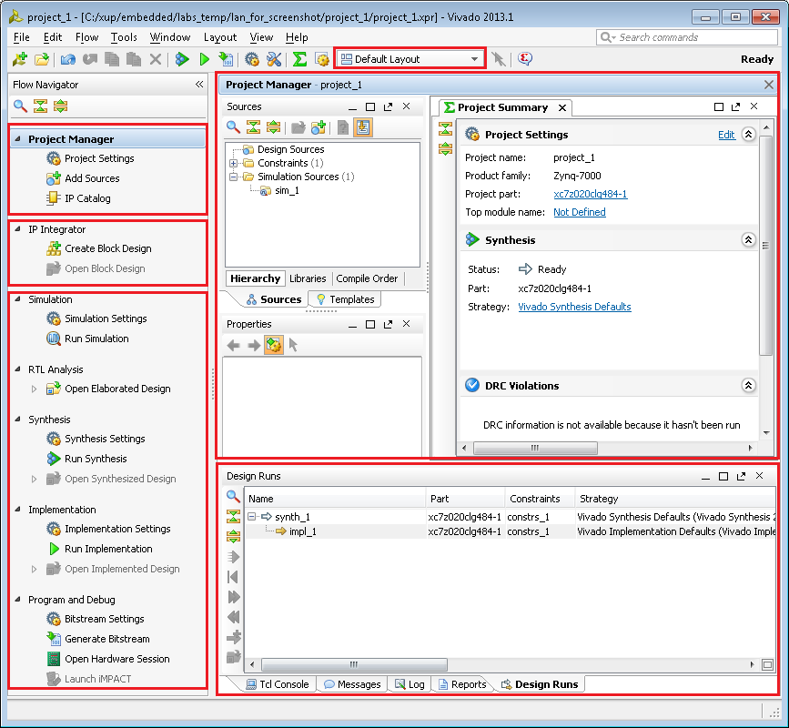
Vivado View
D
A
Customizable panels
A: Project Management
B: IP Integrator
C: FPGA Flow
D: Layout Selection
E: Project view/Preview Panel
F: Console, Messages, Logs
B
E
C
F

Slide 14
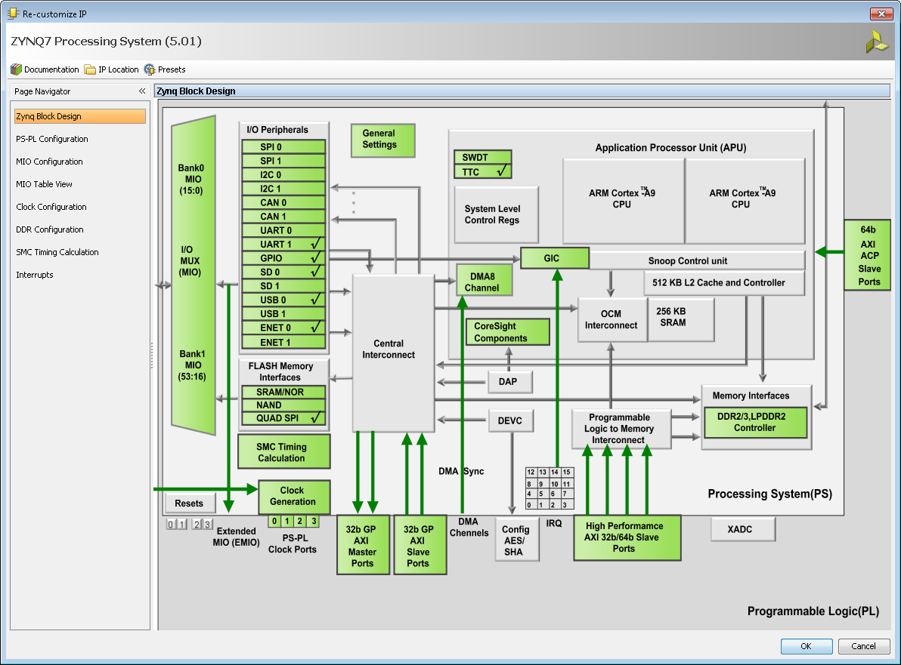
Zynq Customization Processing System
Block Configuration
PS-PL Interface Configuration
MIO Configuration/Table View
Clock Configuration
DDR
SMC Timing Calculation
Interrupt Configuration

Slide 15
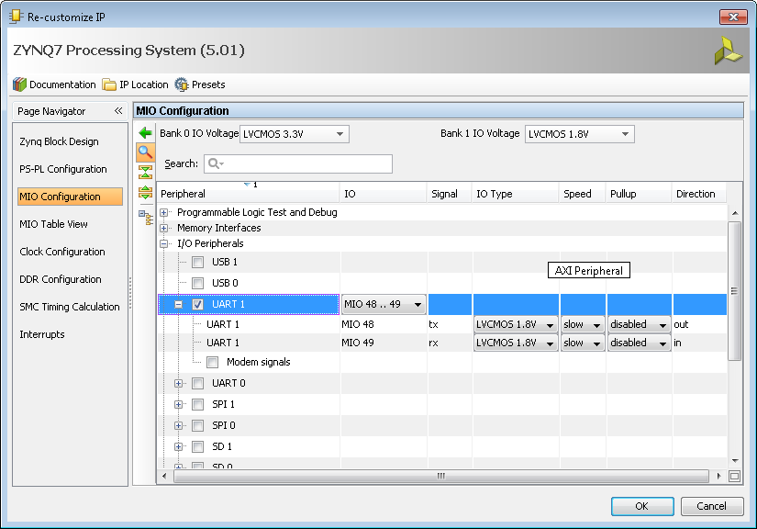
MIO Configuration

Slide 16
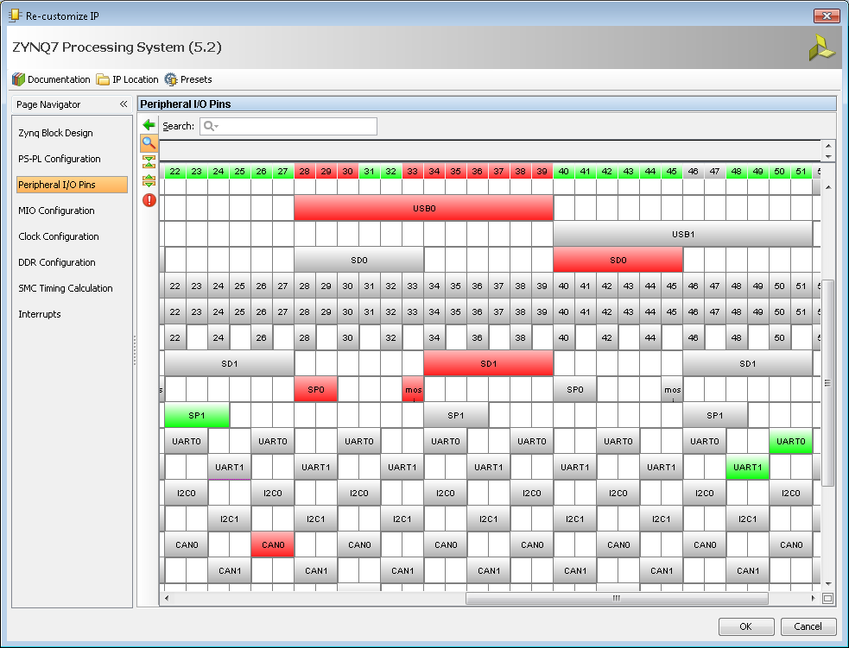
MIO Configuration…

Slide 17
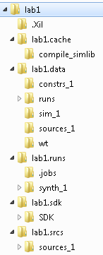
Project Files
Top level Directory
.xpr Vivado Project File (xml file), log files, journal
.srcs
Project source files, IP Integrator files
.data
Vivado database, internal data
.runs
Synthesis, Implementation runs
.sdk
SDK Export directory, Hardware Platform (xml)
.cache
Temporary Files

Slide 18
Outline
Embedded Processor Component
Overview of Vivado
Embedded System Development Flow
Hardware Platform Creation
SDK Software Platform
Summary

Slide 19
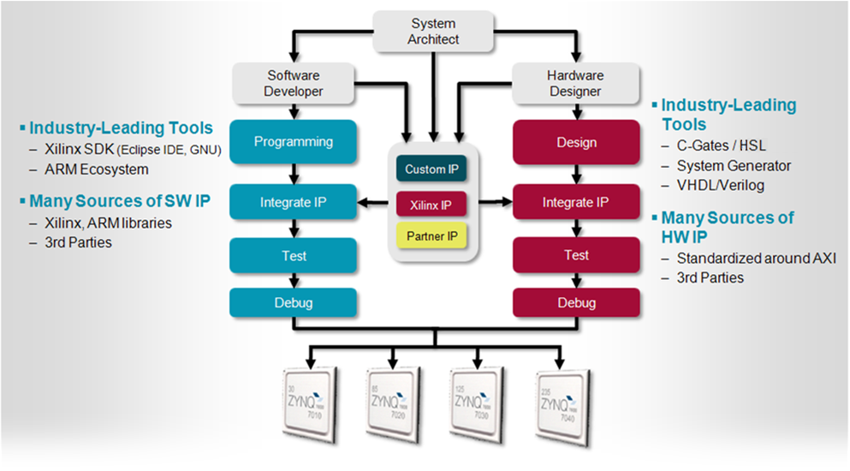
Embedded System Design Flow for Zynq-7000 AP SoC

Slide 20
Embedded System Design using Vivado
Create a new Vivado project, or open an existing project
Invoke IP Integrator
Construct(modify) the hardware portion of the embedded design
Create (Update) top level HDL wrapper
[optional] Synthesize any non-embedded components and implement in Vivado
Export the hardware description, and launch SDK
Create a new software board support package and application projects in the SDK
Compile the software with the GNU cross-compiler in SDK
[optional] Download the programmable logic’s completed bitstream using iMPACT
[optional] Use SDK to download the program (the ELF file)

Slide 21
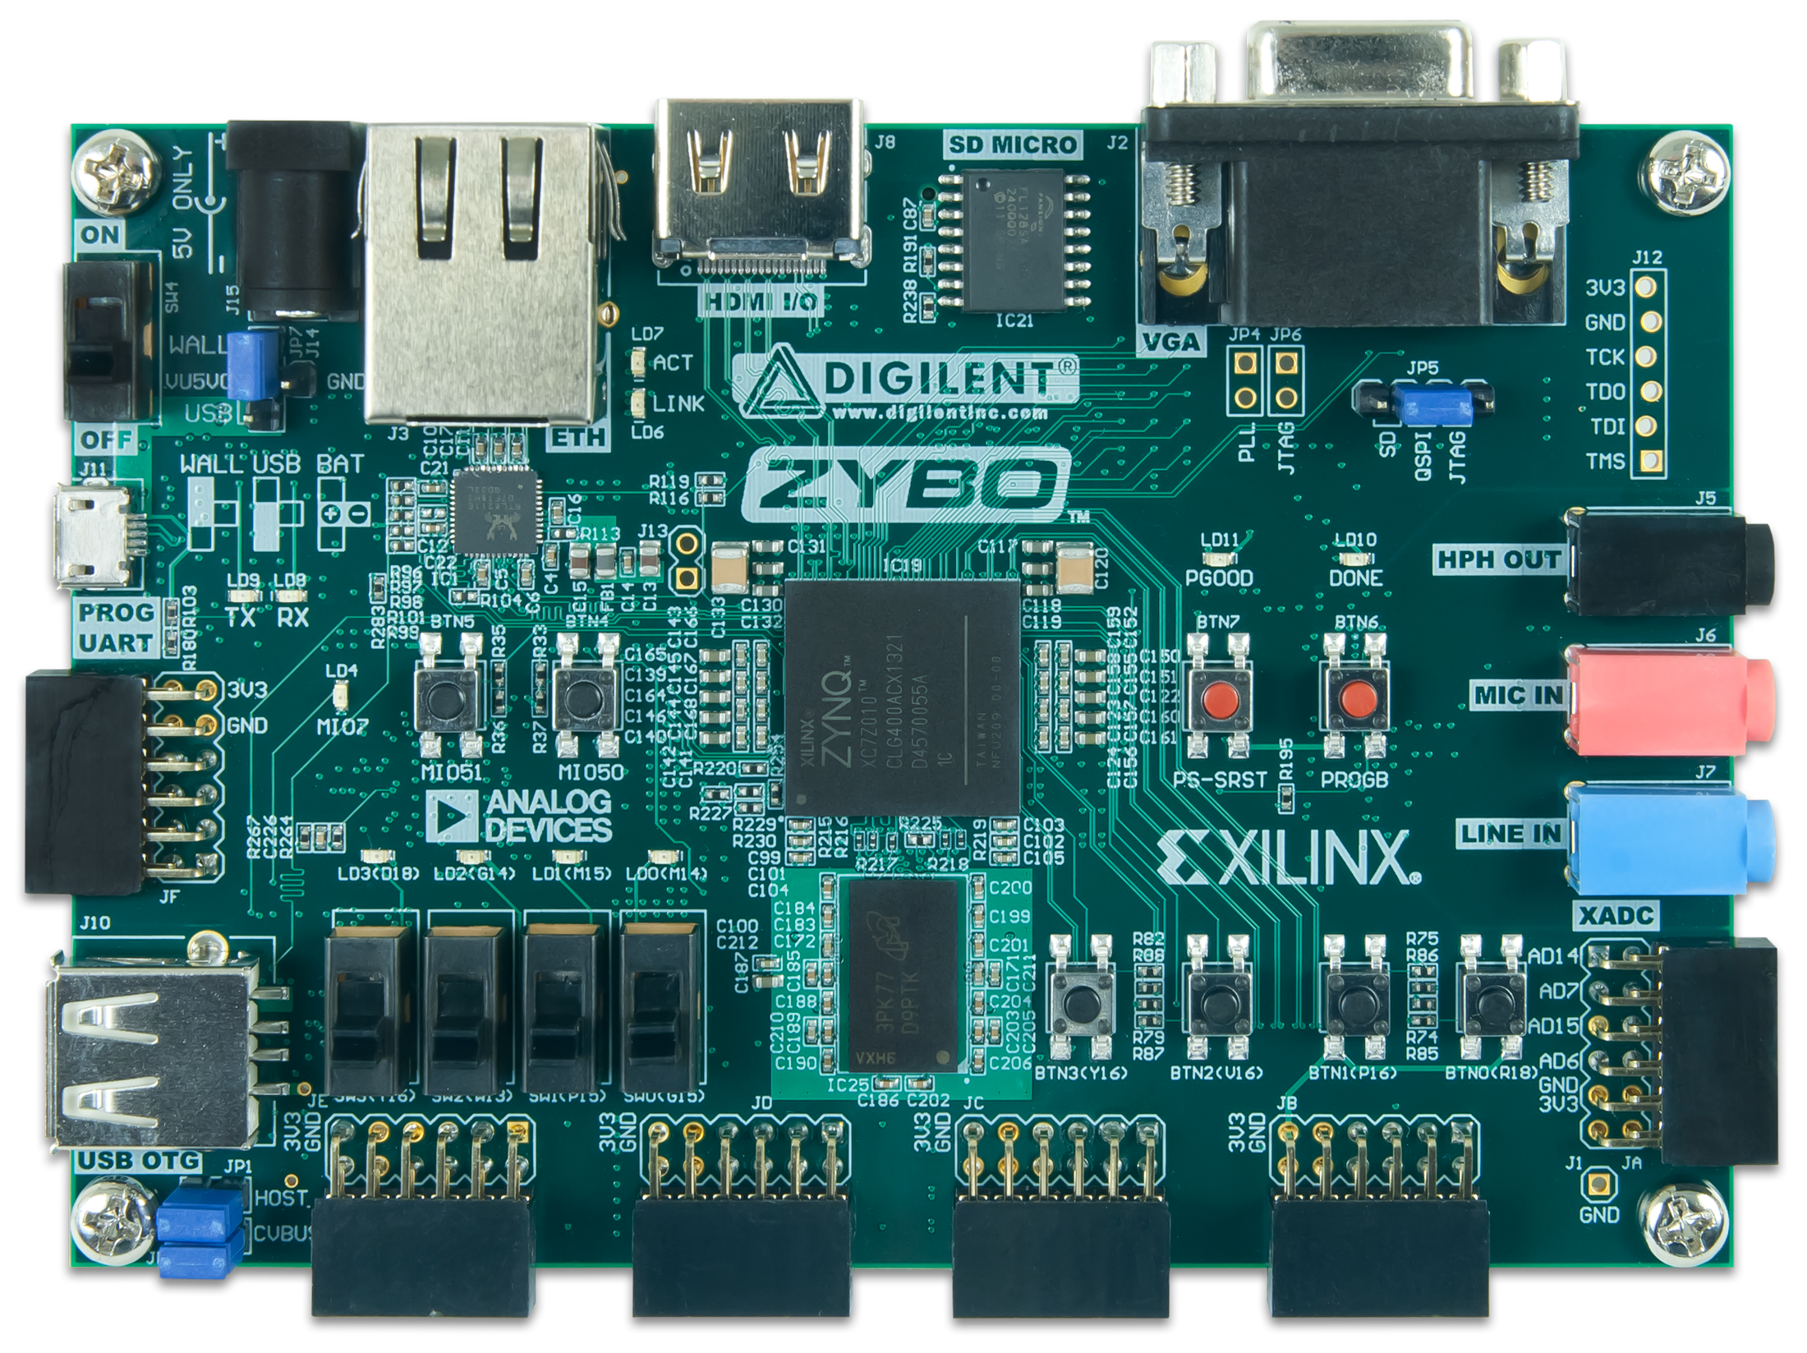
Embedded System Design using Vivado
1. Launch Vivado
2. Invoke IP Integrator to create Block Diagram
5. Generate Top-Level HDL
6. Add Constraints
7. Generate Bitstream => .bit
8. Export hardware to SDK
3. Configure PS settings
4. Add IP & configure
(close Block Diagram, return to Vivado)
9. Specify hardware description from Vivado
10. Add Software Project & Build => .elf
Hardware Configuration
IP Integrator
Vivado
SDK
11. Program bitstream & .elf into Zynq
ZYBO

Slide 22
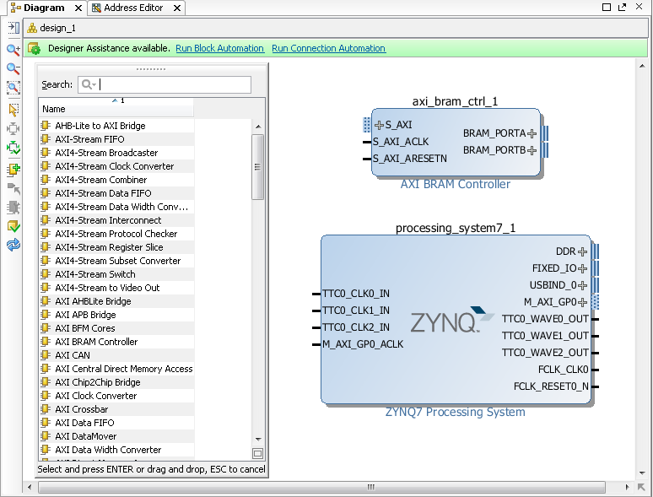
Add IP Integrator Block Diagram
IP Integrator Block Diagram opens a blank canvas
IP can be added from the IP catalog
Drag and drop interface
Intelligent Design environment
Design Assistance
Connection automation
Highlights valid connections
Group, create hierarchal blocks
Can create and import custom IP using IP Packager

Slide 23
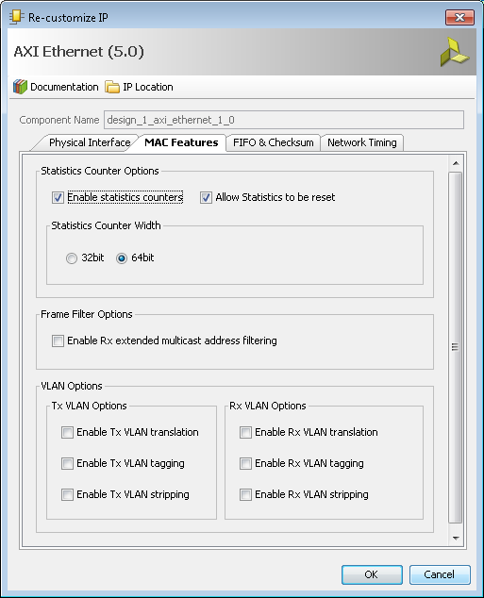
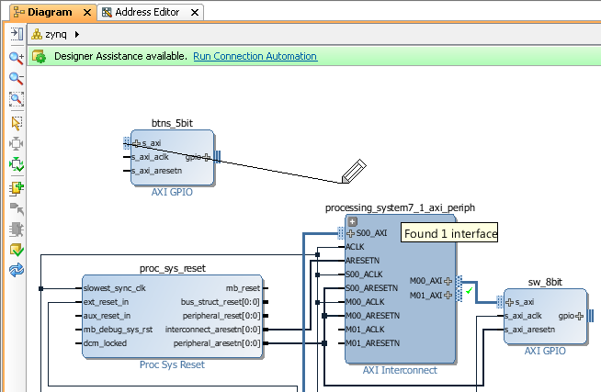
Configuring Hardware in IP Integrator
Double click blocks to access configuration options
Drag pointer to make connections
Highlights valid connections
Connection Automation
Automatically connect recognised interfaces
Automatically Redraw system

Slide 24
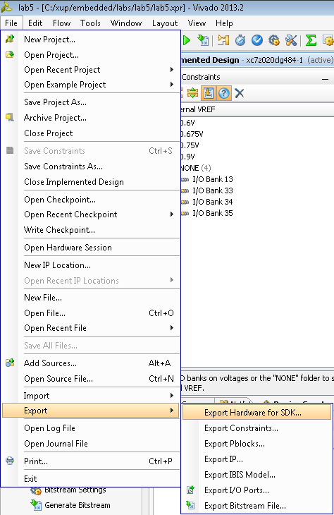
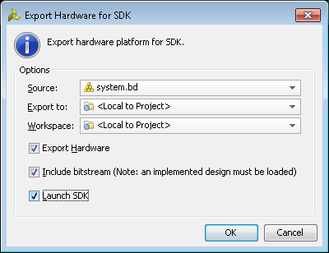
Exporting to SDK
Software development is performed with the Xilinx Software Development Kit tool (SDK)
Hardware configuration in Vivado
An XML description of the hardware is exported to SDK
The hardware platform is built on this description
Only one hardware platform for each SDK project
(Optionally export bitstream)
The SDK tool will then associate user software projects to hardware

Slide 25
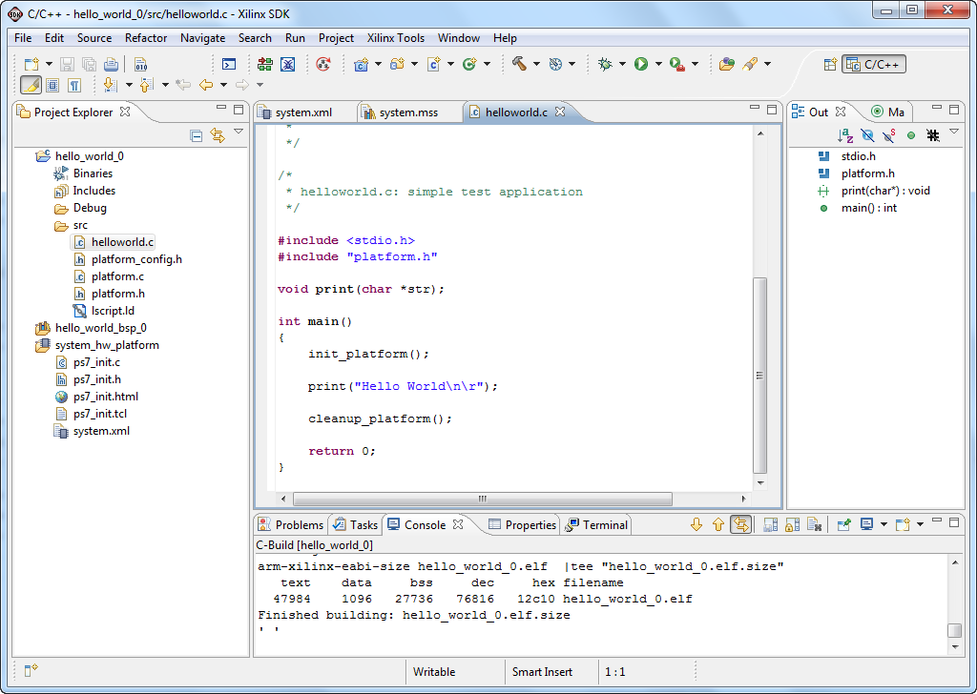
Software Development Flow
Create hardware platform project
Automatically performed when SDK tool is launched from Vivado project
Create BSP
System software, board support package
Create software application
Create linker script
Build project
compile, assemble, link output file <app_project>.elf

Slide 26
Configuring FPGA and Downloading Application
Download the bitstream
Only if PL is used
Input file <top_name>.bit
The Vivado Hardware Manager (or Xilinx iMPACT tool) download the bitstream to the target
The bitstream can be downloaded from either
Vivado
SDK
Requires that the download cable is connected

Slide 27
Outline
Embedded Processor Component
Overview of Vivado
Embedded System Development Flow
Hardware Platform
SDK Software Platform
Summary

Slide 28
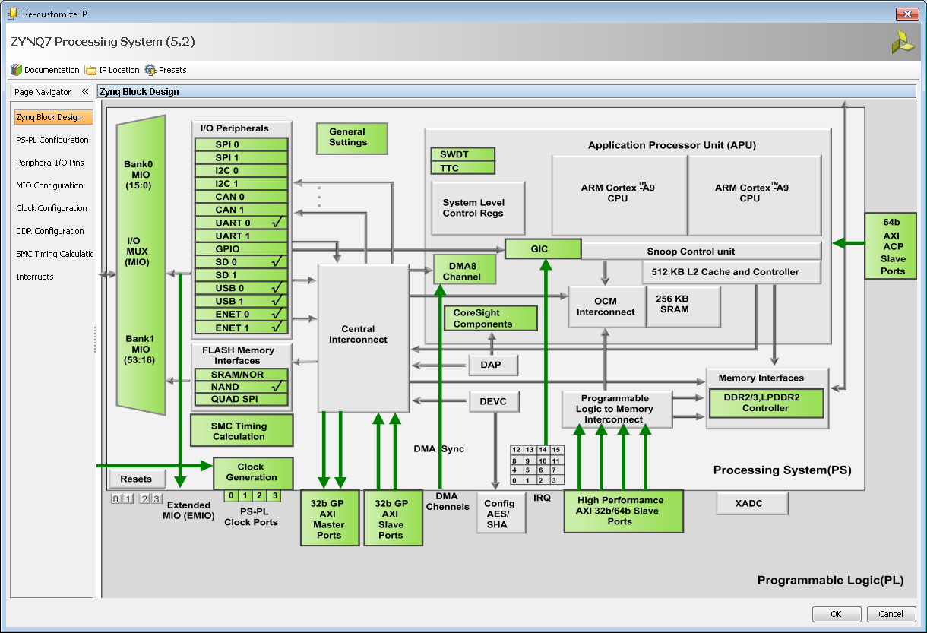
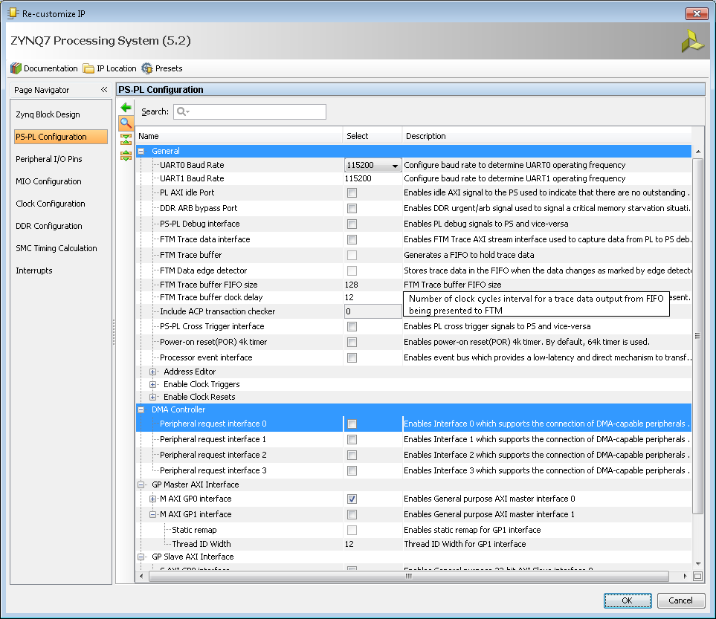
Zynq Configuration GUI
Provides a graphical view of the PS to configure
ARM cores
I/O peripherals
DDR controller
Memory systems
I/O partitioning between dedicated PS pins and programmable logic I/O
Zynq-7000 AP SoC PS is configured via a set of memory-mapped configuration registers

Slide 29
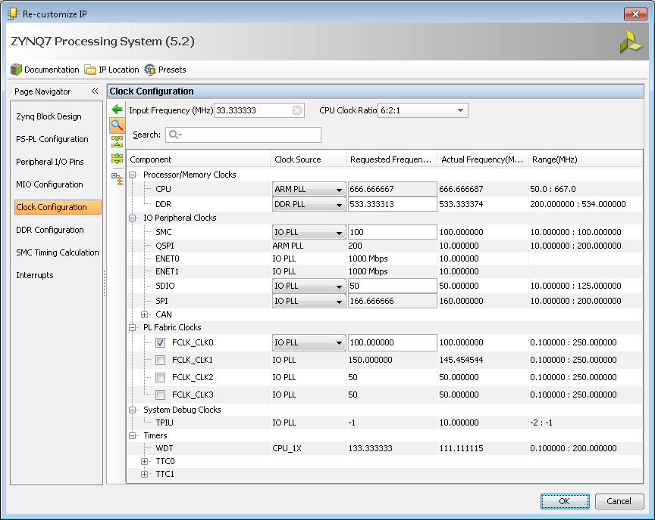
Clock configuration
Clock Configuration
Input frequency can be set
Processor, DDR
All IOP clock frequencies can be set
Clock to PL configuration
Set Timers

Slide 30
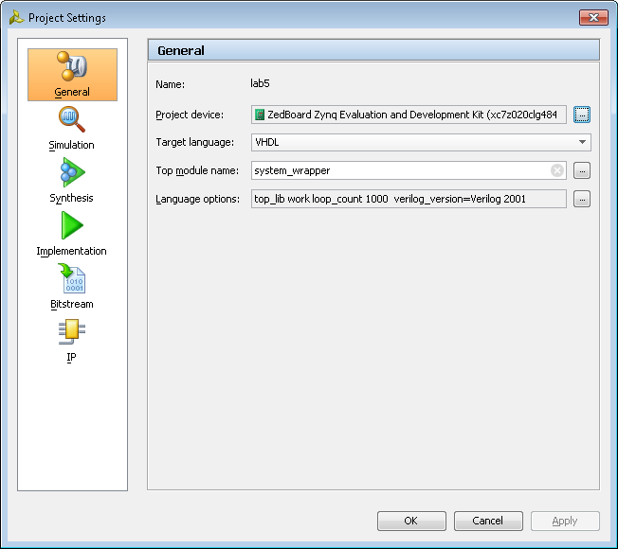
Project Settings
Accessed from flow navigator
Default settings are typically used
Set/change target device
Architecture, Device size, Package, Speed grade
Simulation, Synthesis, Implementation, Bitstream options
IP repository directory
Provide path to custom IP not present in the current project directory structure

Slide 31
Outline
Embedded Processor Component
Overview of Vivado
Embedded System Development Flow
Hardware Platform Creation
SDK Software Platform
Summary

Slide 32

Software Development Kit (SDK)
Full-featured software design environment
Separate tool from Vivado – can install standalone for SW teams
Based on popular Eclipse open-source IDE
Used for software applications only; hardware design and modifications are done in Vivado
Well-integrated environment for seamless debugging of embedded targets
Sophisticated software design environment with many options and features with support for
Multiple processors
Multiple software platforms
Multiple software applications
Fully Featured C/C++ code editor and error navigator

Slide 33
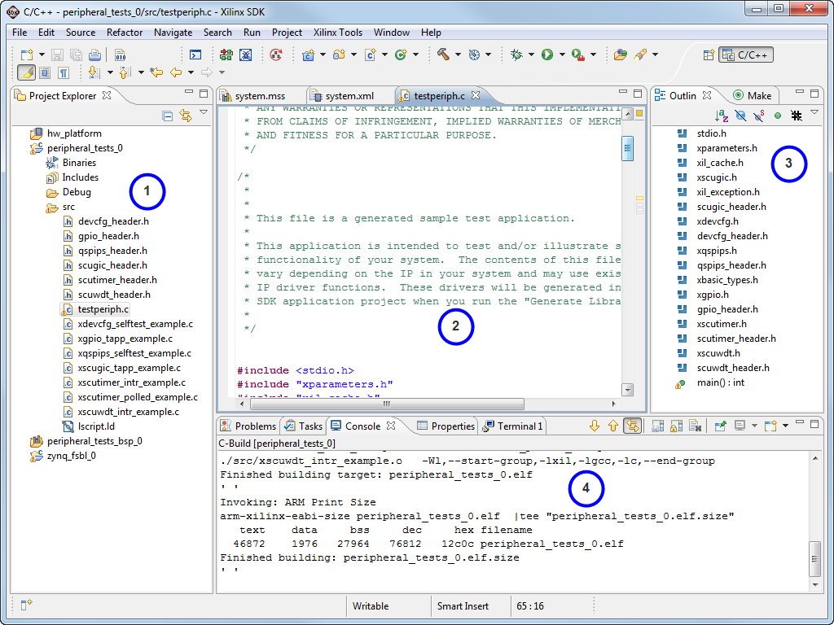
SDK Workbench Views
C/C++ project outline displays the elements of a project with file decorators (icons) for easy identification
C/C++ editor for integrated software creation
Code outline displays elements of the software file under development with file decorators (icons) for easy identification
Problems, Console, Properties views list output information associated with the software development flow

Slide 34
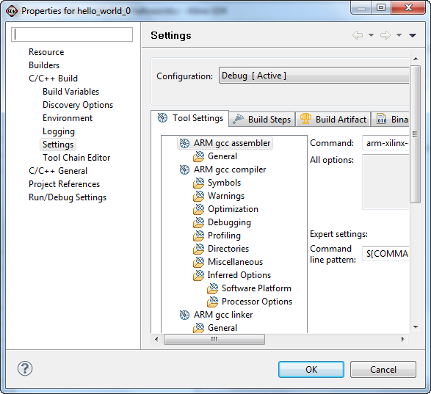
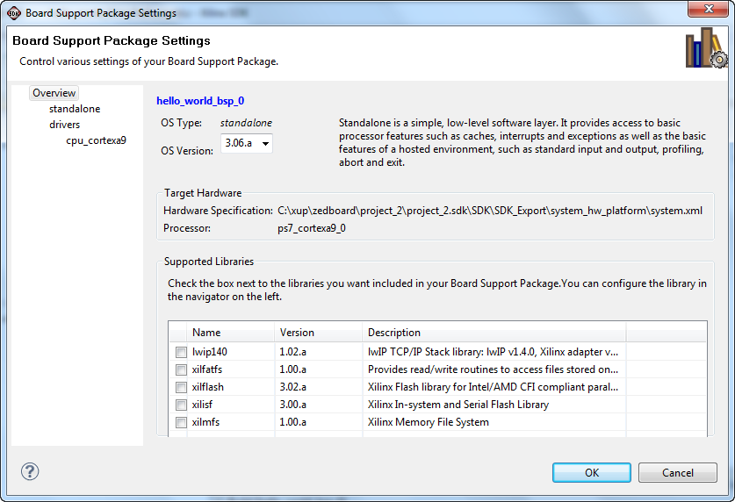
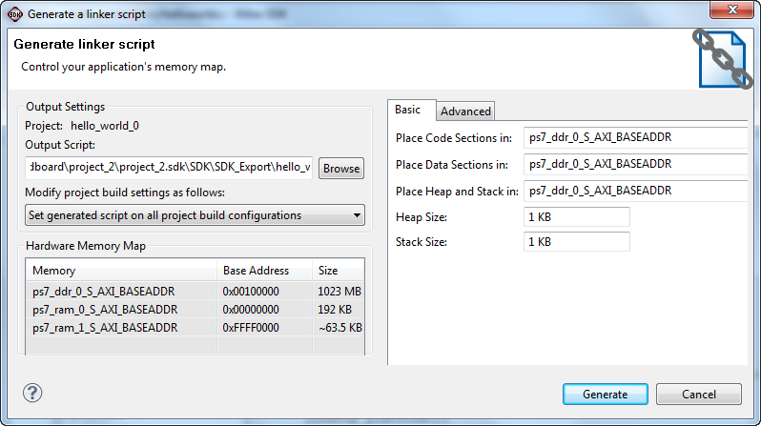
Software Management Settings
Software is managed in three major areas
Compiler/Linker Options
Application program
Software Platform Settings
Board support package
Linker Script Generation
Assigning software to memory resources
Covered in more detail later

Slide 35
Outline
Embedded Processor Component
Overview of Vivado
Embedded System Development Flow
Hardware Platform Creation
SDK Software Platform
Summary

Slide 36
Summary
Vivado includes all the tools, documentation, and IP necessary for building embedded systems
IPI is a System Level design tool that increases productivity, allowing designs to be completed faster
The Software Development Kit (SDK) is a comprehensive software development environment for software applications
An embedded processing system component is built with IP provided in the IP Catalog. Designers can also add their own custom IP to this catalog
The PS Configuration wizard permits access to several configurable features of PS

